Slide 1
Police Violence in 2015 & 2016 in the United States
By: Efezino John Erome-Utunedi

Slide 2
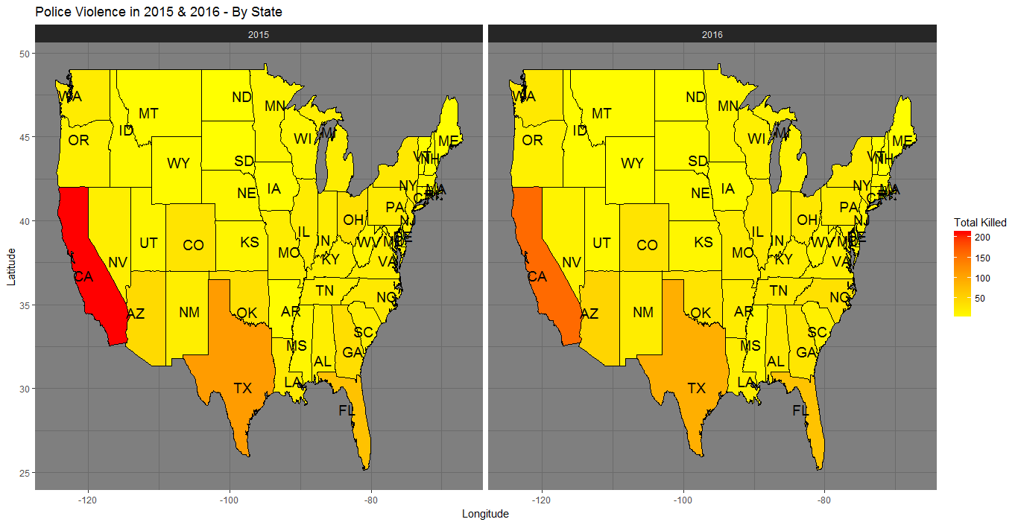
R Visualization and Data Exploration
Most populated states contain most number of deaths

Slide 3
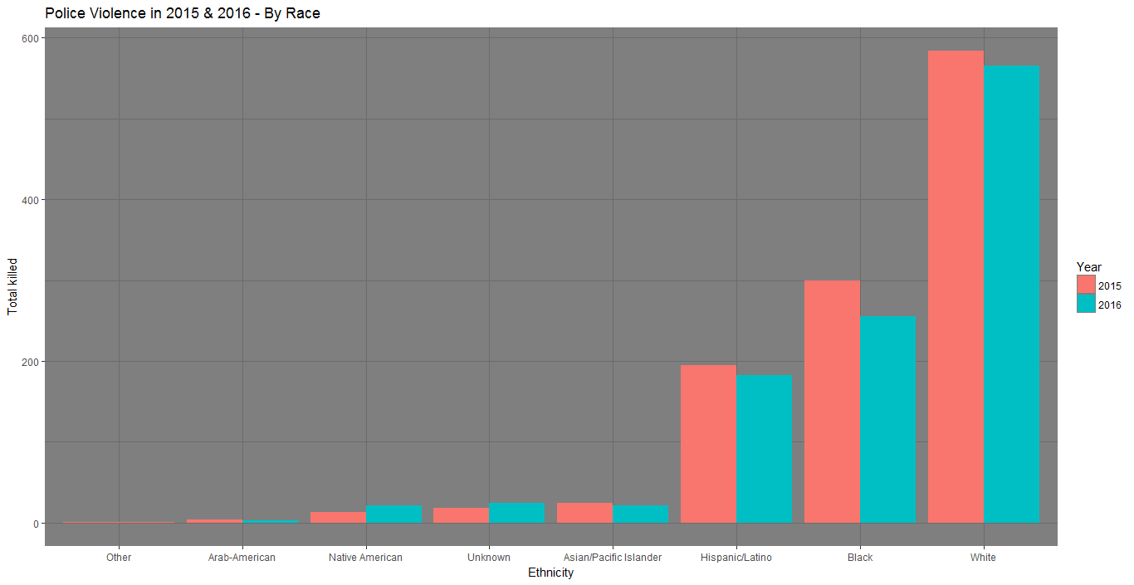
R Visualization and Data Exploration
To no surprise, top 3 demographics in the united states contain ~95% of of people killed by the police in the United States
Notes:
Total of 2214 in 2015 and 2016
1079/1139 (94%) in 2015 and
1005/1075 (93%) in 2016
Total of 94%

Slide 4
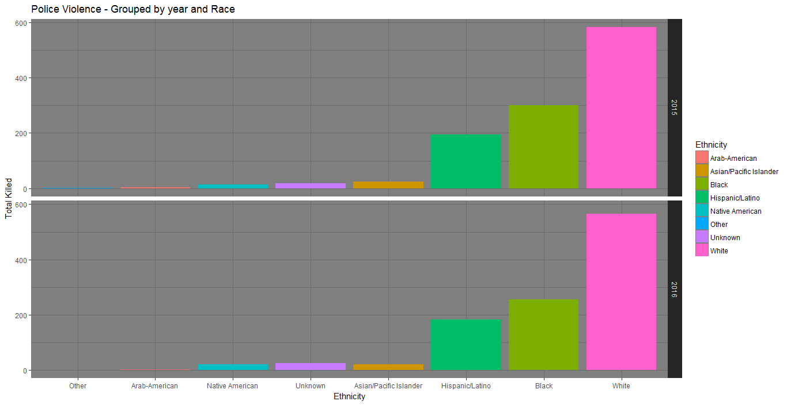
R Visualization and Data Exploration
A small drop in police violence from 2015 to 2016 but it is relatively consistent for each ethnicity
Notes:
101 women total in 2015 & 2016, 48 women in 2015, 53 women in 2016
1982 men in total in 2015 & 2016, 1030 men in 2015, 952 in 2016
2084 total male and female,

Slide 5
R Visualization and Data Exploration
Ethnicity | 2015 | 2016 | Total
Arab-American | 4 | 3 | 7
Asian/Pacific Islander | 24 | 21 | 48
Black | 300 | 256 | 556
Hispanic/Latino | 195 | 183 | 348
Native American | 13 | 21 | 34
Other | 1 | NA | 1
Unknown | 18 | 25 | 43
White | 584 | 566 | 1150
Notes:
101 women total in 2015 & 2016, 48 women in 2015, 53 women in 2016
1982 men in total in 2015 & 2016, 1030 men in 2015, 952 in 2016
2084 total male and female,

Slide 6
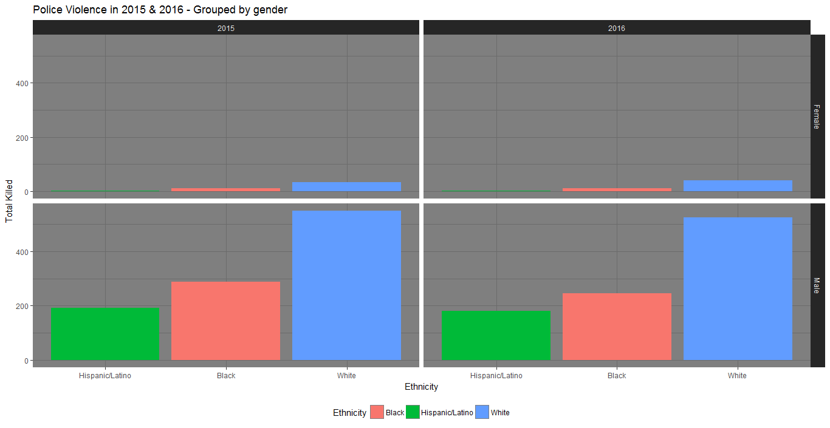
R Visualization and Data Exploration
Small percentage of women consist of total group killed by police in 2015 and 2016
Will be focusing on the male gender with white, black and hispanic/latino ethnicity

Slide 7
R Visualization and Data Exploration
Ethnicity (Female) | 2015 | 2016 | Total
Black | 11 | 11 | 22
Hispanic/Latino | 3 | 2 | 5
White | 34 | 40 | 74
Ethnicity (Male) | 2015 | 2016 | Total
Arab-American | 284 | 245 | 529
Asian/Pacific Islander | 191 | 181 | 372
Native American | 550 | 526 | 1076

Slide 8
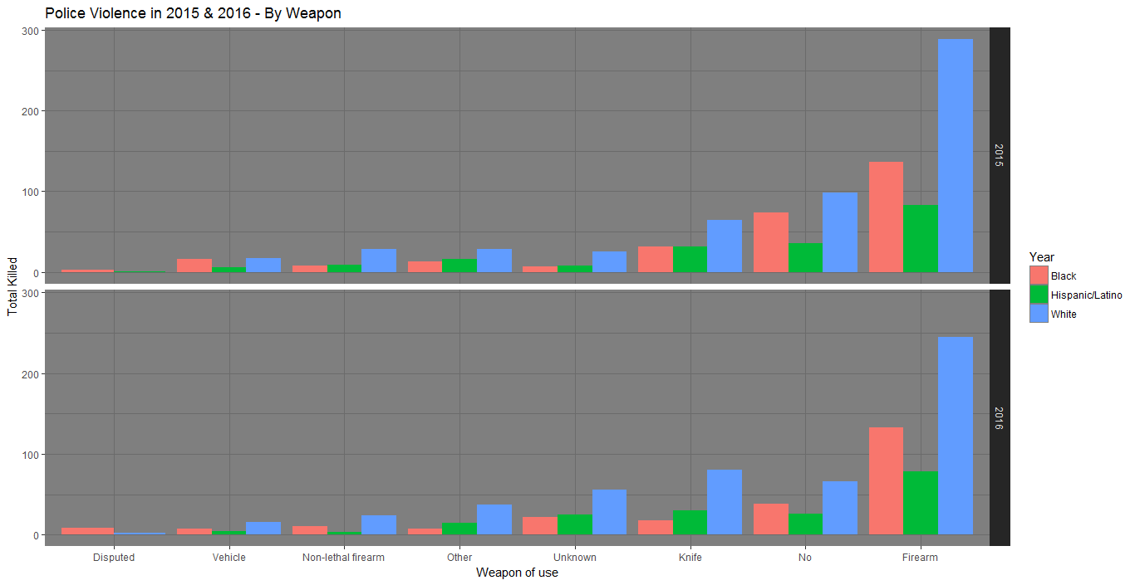
R Visualization and Data Exploration
Obvious that firearm would be top weapon of choice but what is more interesting is that the second most number of kills based by weapon choice was ‘No’.
Notes:
~ 20% killed although they had no weapons
~ 50% killed since they had firearms

Slide 9
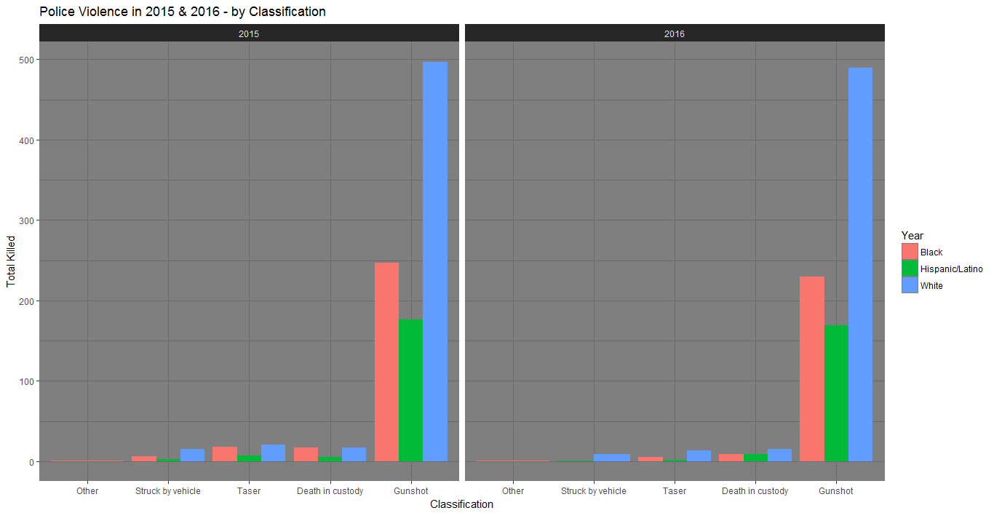
R Visualization and Data Exploration
R Visualization and Data Exploration
Since huge percentage of people were armed with guns, it makes sense that gunshot was the reason of death based on race
Notes:
~ 90% killed by gunshot

Slide 10
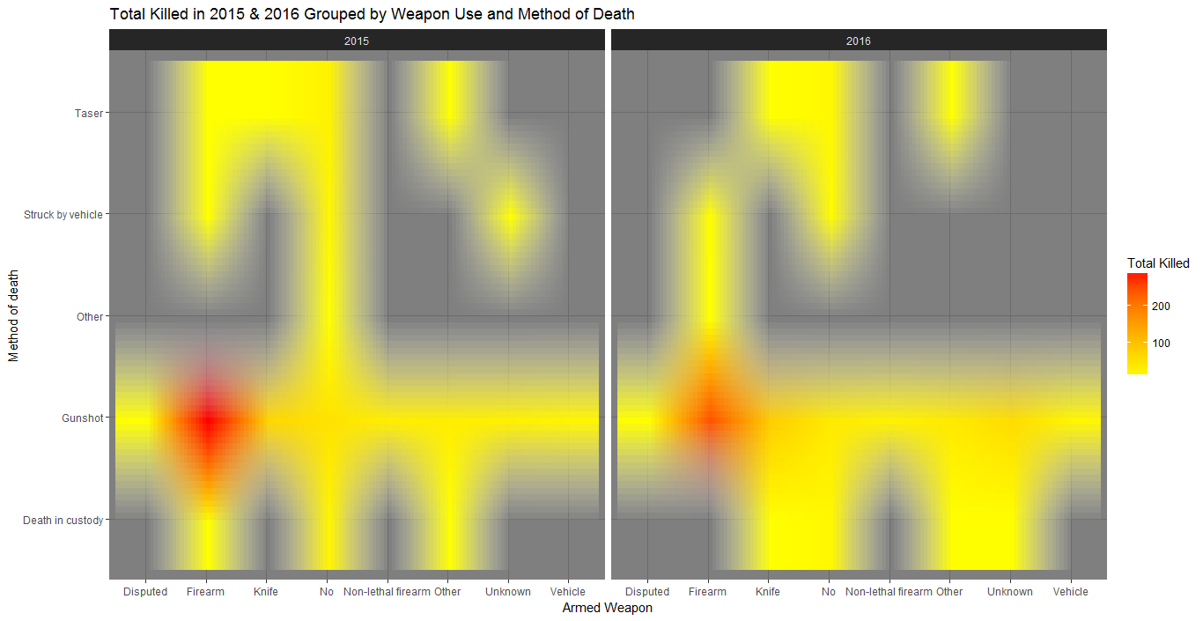
R Visualization and Data Exploration
More direct relationship between the weapon of use and method of death

Slide 11
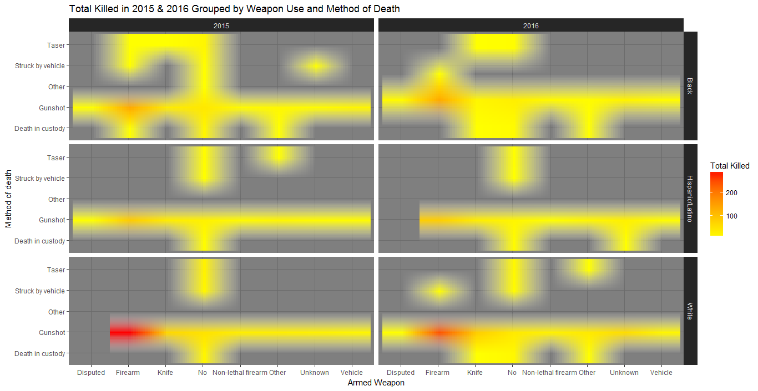
R Visualization and Data Exploration

Slide 12
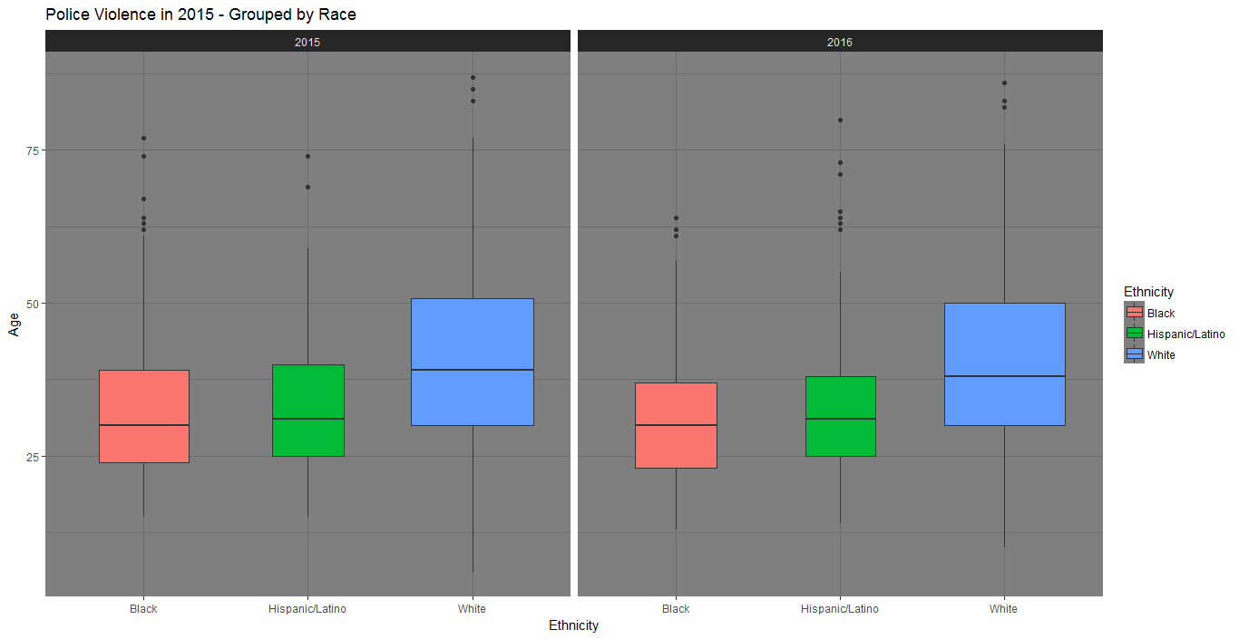
R Visualization and Data Exploration
Obvious that firearm would be top weapon of choice but what is more interesting is that the second most number of kills based by weapon choice was ‘No’.

Slide 13
Conclusion
Interesting that the data presented today can used to show that white people are killed more than any other ethnicity but at a closer look, if the percentage of different ethnicities are taken, it will be obvious that more black people are killed by police than white people
Same data can be used to tell very different stories
Will be interesting to compare this data against black on black crime
The data is also not complete since not all police departments could provide this data

